Slide 1
Git Using ---------------- GitHub / Bitbucket
Version Control (system / tool / software)
www.codehafeez.com

Slide 2
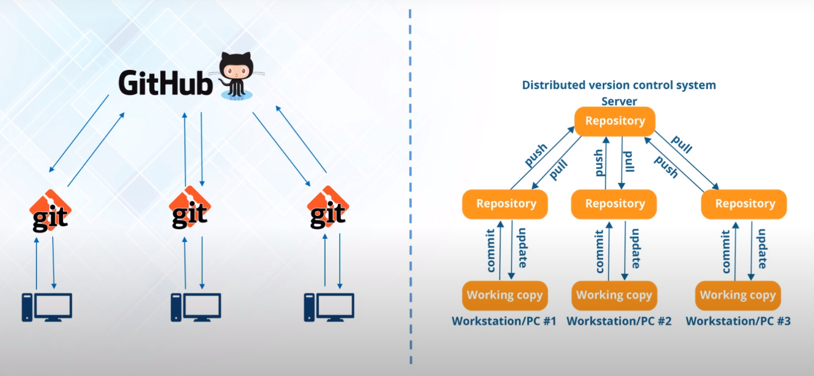
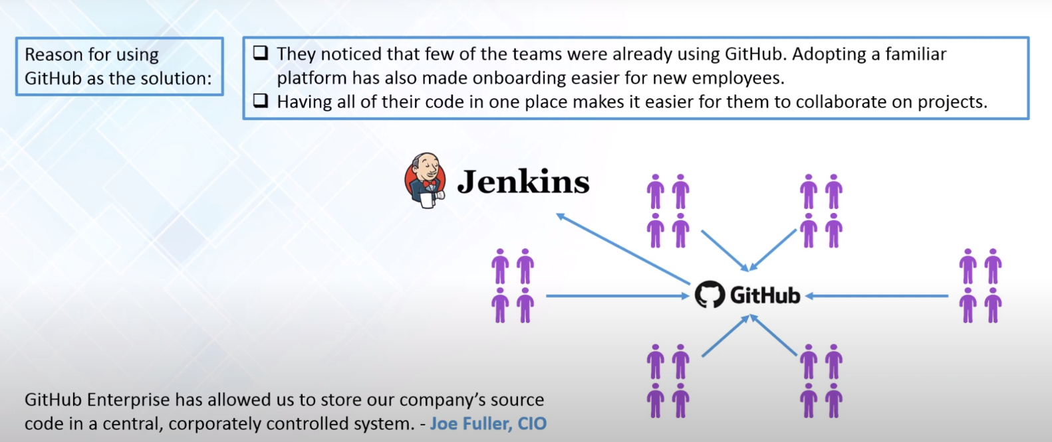

Slide 3
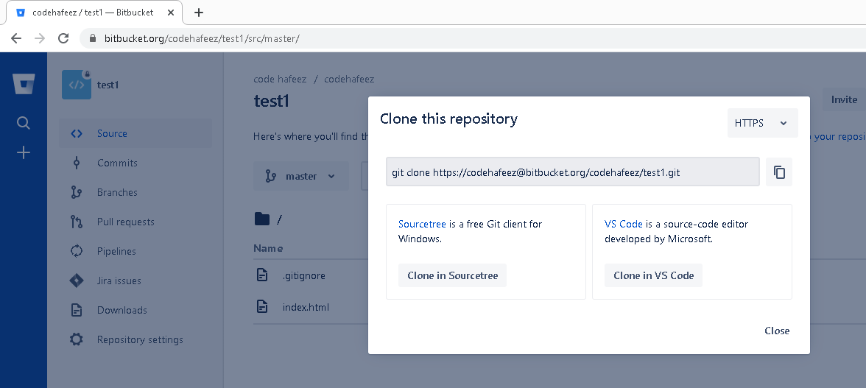
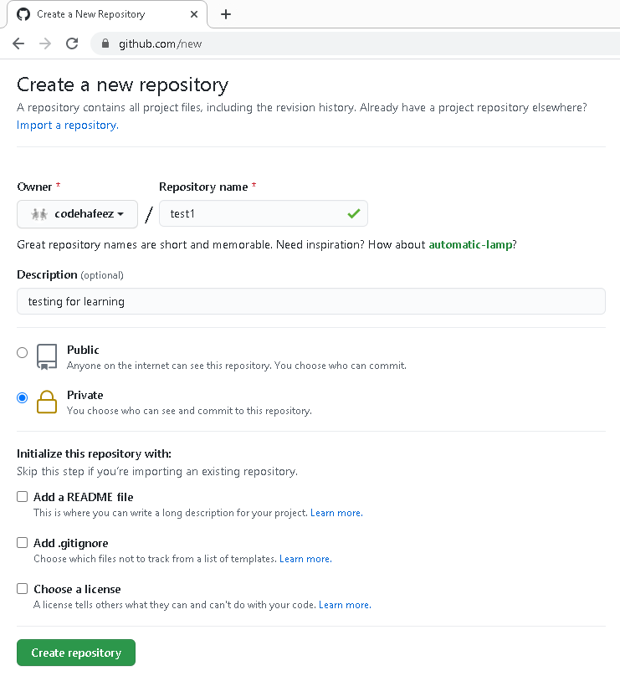
GitHub & Bitbucket = Both same commands

Slide 4
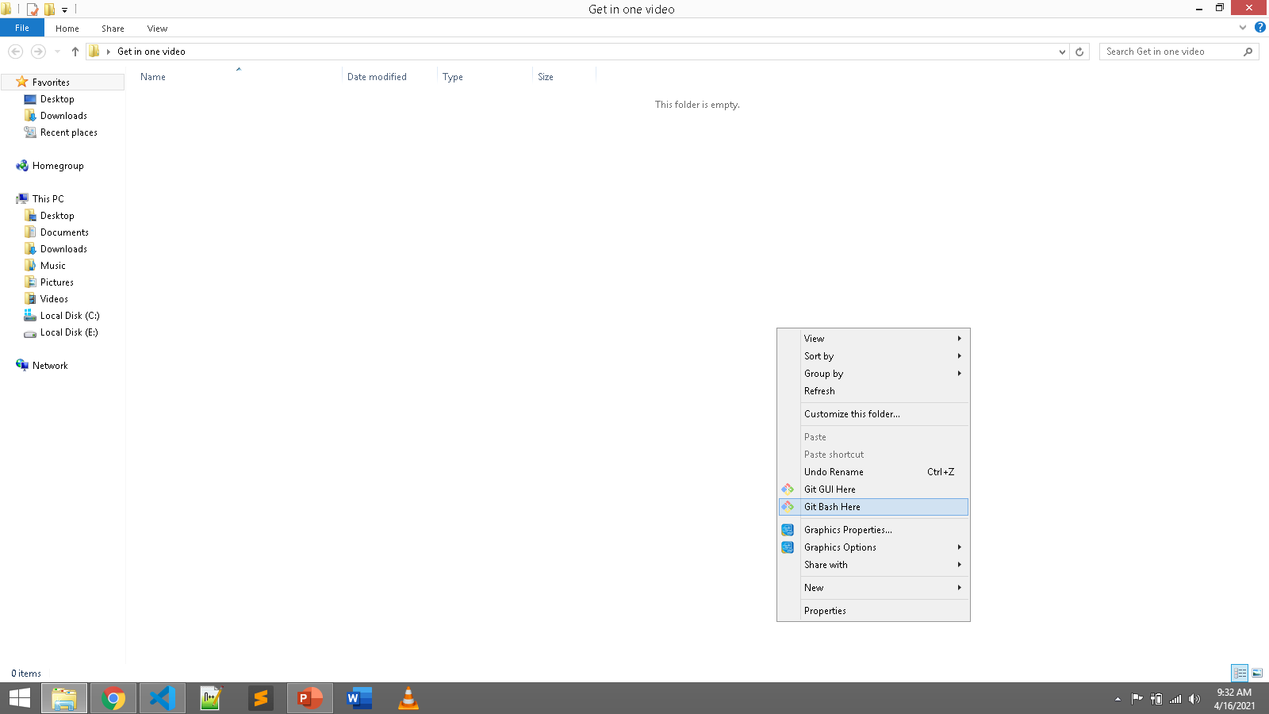
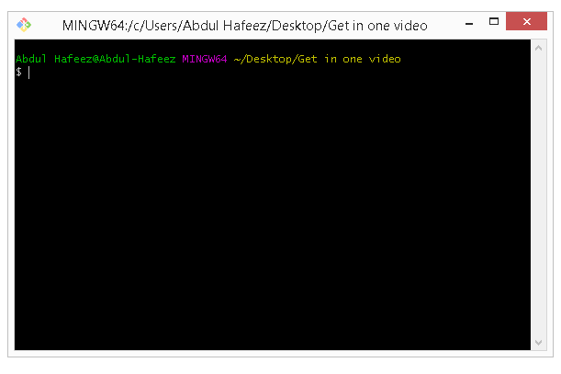

Slide 5
Download Files - GitHub commands
git init
git clone https://github.com/codehafeez/test1.git
OR
git init
git clone https://codehafeez@bitbucket.org/codehafeez/test1.git

Slide 6
Upload Files - GitHub commands
git init
git add .
git commit -m "first commit"
git remote add origin https://github.com/codehafeez/test1.git
git push -u origin main

Slide 7
Update Files - GitHub commands
git init
git add .
git commit -m "second commit"
git remote push origin https://github.com/codehafeez/test1.git
git push -f origin main

Slide 8
Update Files - GitHub commands (Detail)
git init
git add index2.html
git commit -m "second commit"
git status
git remote push origin https://github.com/codehafeez/test1.git
git push -f origin main
git log

Slide 9
Delete File - GitHub commands
git init
git rm file1.txt
git commit -m "remove file1.txt"
git remote push origin https://github.com/codehafeez/test1.git
git push -f origin main

Slide 10
Download Previous Backup - Go Back Version
git log
git checkout (9d8037c9b3d5d195a5730e863a4d32cc565101dd) => <commit-id>
Or //specific file
git checkout (9d8037c9b3d5d195a5730e863a4d32cc565101dd) => <commit-id> index.html
git status
git reset HEAD index.html // if you don’t find reset
git checkout -- index.html // if you don’t find reset

